Slide 1

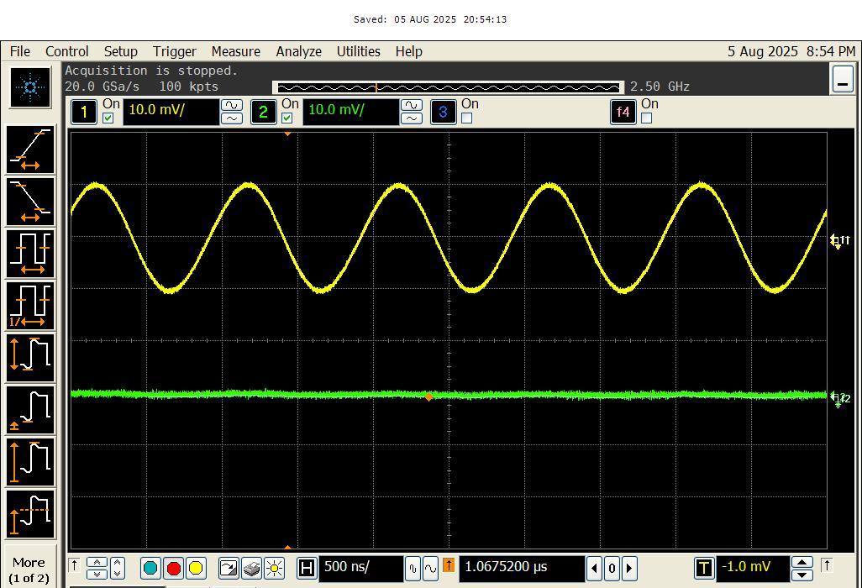
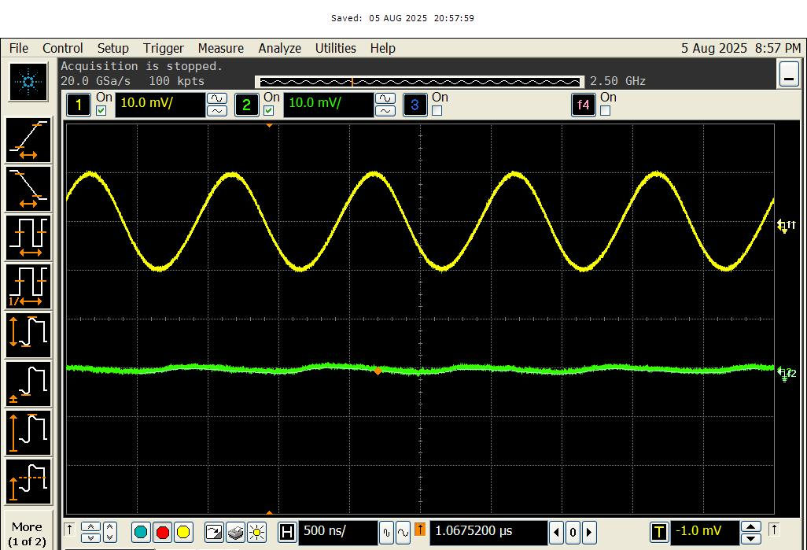
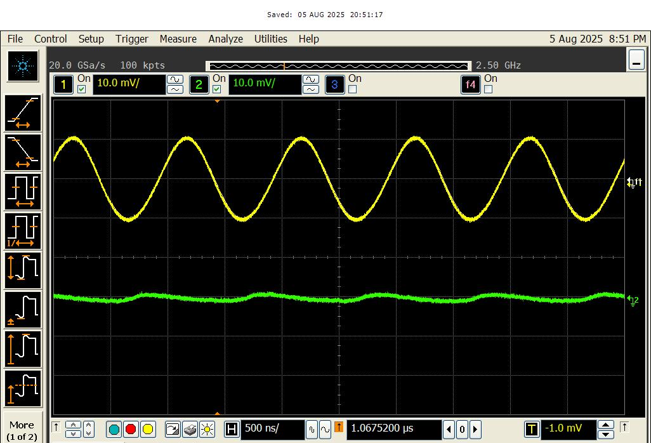
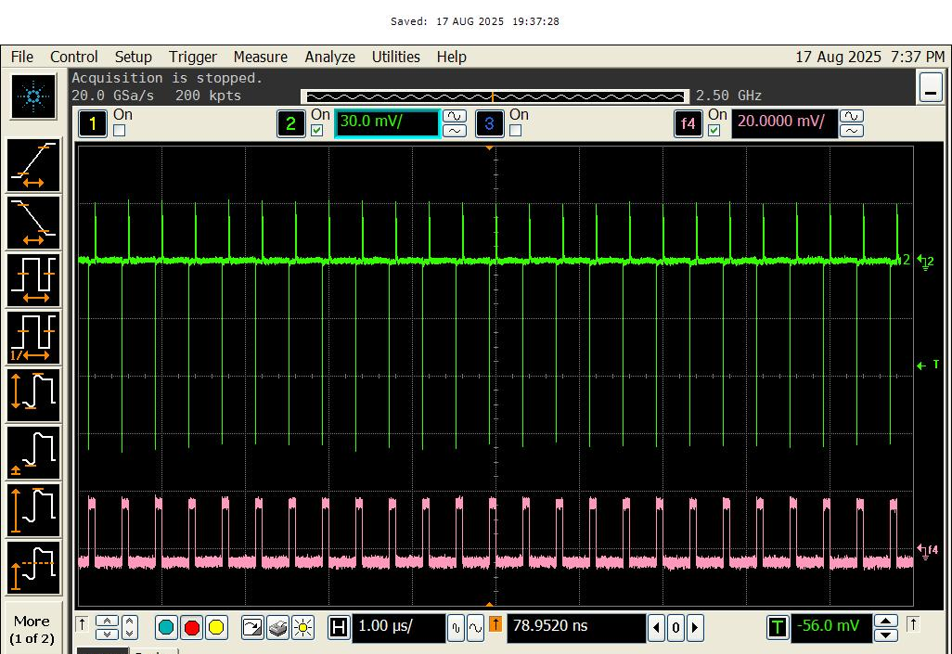
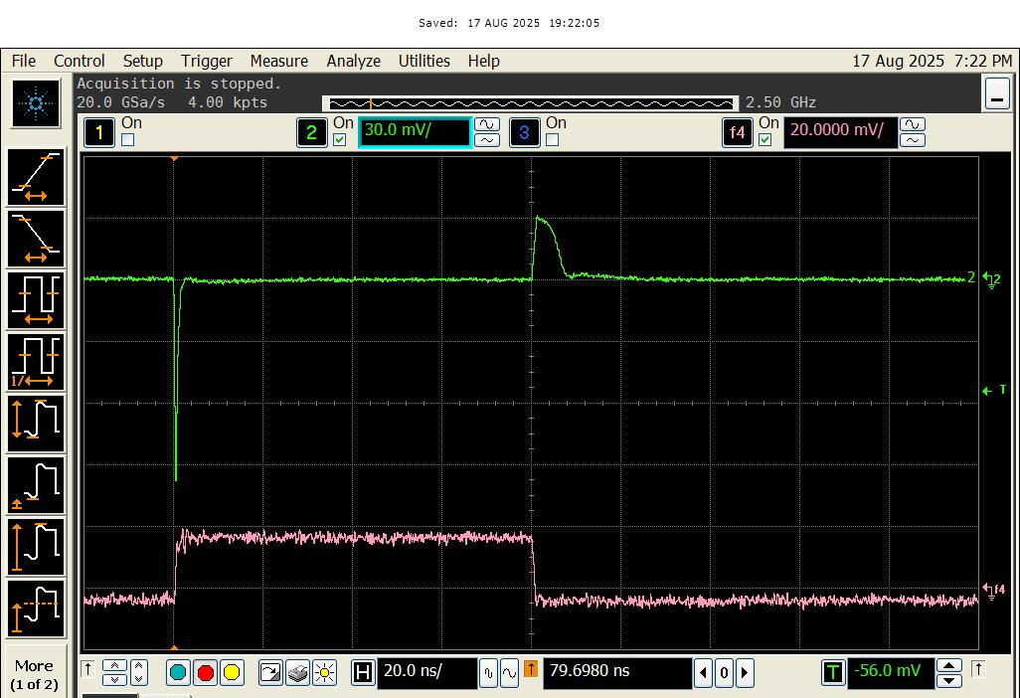
Fast Transient LDO Regulator
Donghyeok Cho¹ and SeongHwan Cho¹
¹KAIST, Daejeon, Korea
Introduction
Implementation, Measurement Results
  Semiconductor systems generally employ low-dropout regulators (LDOs) to suppress supply-voltage noise. However, since voltage droop caused by load events can be critical to system operation, the regulator must respond rapidly to compensate for the droop. In general, such fast response requires a high quiescent current. For semiconductor systems that remain in the standby state for long periods, however, an architecture with high quiescent current significantly degrades overall system efficiency. In this work, we propose a multi-stage LDO that achieves good droop performance with low quiescent current. Specifically, the proposed LDO regulator achieves 99mV of droop when load transient of 170mA/1.2ns is applied at 30mV dropout. As it consumes 7.7uA at steady-state regardless of load condition and it supports maximally 326mA at 30mV dropout, it achieves 99.998% of maximum current efficiency.
Implemented Analog LDO
Relation between peak response time and droop
Chip micrograph
Droop response of an output-capacitor-less LDO
- Output-capacitor-less LDO’s output can be considered as a resistance.
- As it undergoes abrupt droop when steep load step is applied, shorter peak response time is required than edge time to suppress droop.
(a) (b)
Proposed Current-Amplification-Based Analog LDO
(c) (d)
Measured transient waveform when 1MHz AC input is applied at 30mV dropout with the following load conditions: (a) 0mA (b) 10mA (c) 50mA (d) 200mA
Conventional analog LDO (a) and the proposed current-amplification-based LDO (b)
- Current amplifier is inserted between error amplifier and pass transistor.
- Error amplifier now behaves as transconductance stage as current amplifier has low input impedance.
- Current amplifier amplifies only error current from the transconductance stage.
(a) (b)
Measured transient waveform when 170mA/1.2ns load is applied at 30mV dropout, 10mA initial current condition (a) and magnified waveform (b)
Acknowledgement
The chip fabrication and EDA tool were supported by the IC Design Education Center(IDEC), Korea.

